Slide 1

Online Railway reservation system
My Learning curve

Slide 2
Project mission and objectives
Designing a platform to book tickets online by just logging into system.
An attempt to create online platform for web/mobile users paving way to travelling.

Slide 3
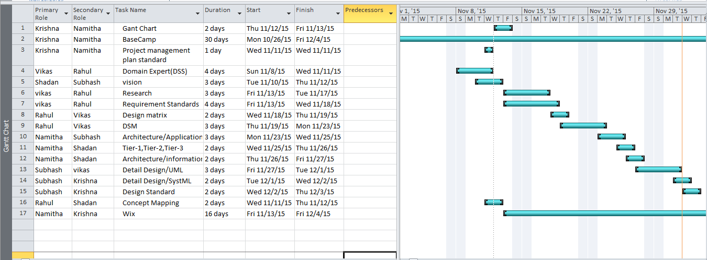
Role Layout with assigned work Chart

Slide 4
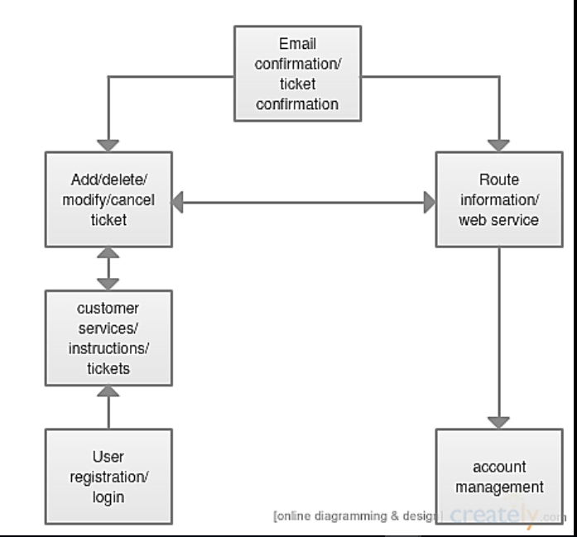
Requirement planning panned out as a flow diagram
To create a distributed system that will be used by the customers
To ensure that ticket reservation is easy and user friendly for customers
To satisfy customers need by reaching them at their place reducing the work load of the ticket officers by proving large number of tickets reservation and cancellation service using internet through different electronic devices like Smart mobile systems, PAD’s, etc in few minutes.

Slide 5
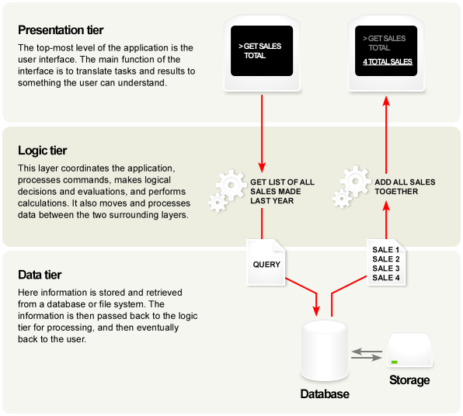
Picture with Caption Layout
It's debatable what counts as "tiers," but in my opinion it needs to at least cross the process boundary. Or else it's called layers. But, it does not need to be in physically different machines. Although I don't recommend it, you can host logical tier and database on the same box.

Slide 6
Design of the system
A domain model is indispensable in most projects. It gives the technical staff a consistent, clear and unambiguous understanding of the domain vocabulary. A UML class diagram is the best notation for this (yes, even better than an English language glossary).
A use case model (that's model, not diagram) is much easier to manipulate than a dozen Word documents (depending on your choice of UML tool, of course) and so I'd recommend to follow the UML route in documenting your use cases. The UML tool will almost certainly allow you to assign additional information to your use cases, such as test scripts, metrics etc. Having this in a model will allow you to create custom reports on this extra information.
Beyond that, I'd say that if we need a state diagram, use a UML state diagram; if you need a flow chart, use a UML activity diagram; if you need a call graph, use a UML sequence diagram. In each case, the UML notation is going to be more widely understood than whatever ad hoc notation.

Slide 7
UML designed:

Slide 8
Architecture tradeoff analysis method
Given the architecture and system design for development meets the requirements, constraints, performance and quality attributes that define customer and user need of system.
Evaluating ATAM in compliance of metrics
Bottom up methodology
Configuration management
Performing the ATAM forces preparation, documentation, understanding of proposed software system and its architecture.
Quality functional development in ATAM used to determine applicability and provide rational basis for proposed architecture concepts and proposed system design for given program.
As this is seed model as beginnings seems small and they eventually grow in complexity and completeness.
They ensure correct versions of documents/data/metrics needs to be used. Also have tight coordination with system engineering to all plans, procedures and archiectures follow CM process.

Slide 9
Designing for operations
An evaluation of the extent of the change the new system introduces must be factored into the system such that the operators of the system can adapt to the change.
Which of the issues associated with the “as-is” system must be addressed. If we implement new processes and systems without curing existing ills, the project will lose credibility, or worse, be rejected.
No new product or solution is devoid of the current state. Even when new systems, products or services are created, they must fit into the current environment and infrastructure.
In addition, most projects are not entirely new products, but replacements and enhancements of existing systems or processes.
Even for brand new products, there are many business rules and decisions that apply across projects that should be taken into account for the project at hand.

Slide 10
System tiers
Presentation Tier: This tier responds to service requests from the Service Layer and issues service requests to the Mission/Business Process Tier. The Presentation Layer relieves the
Mission/Business Application Services Tier: The Services Tier provides the mechanism for managing the dialogue between end-user business application processes. It provides and establishes check-pointing, adjournment, termination, and restart procedures.
Mission/Business Processes Tier: This processes tier is a service tier that provides the services necessary for the business applications to run and communicate effectively across the enterprise.
Persistent Services Tier: The Persistent Services Tier can be looked at as a way to access objects within the enterprise storage system. This includes data resource integration that abstracts out the information regarding data object storage such that the Persistent Services Tier contains the concept of Data Access Objects (DAOs).
Data Access Tier: The system’s database clusters will normally use a relational database(s). The use of Data Access Objects for data access is indispensable in providing the methods to store database objects and flat files (e.g., log files and legacy data files from legacy systems).

Slide 11
System tiers continued
Data Storage Tier: The use of Data Access Objects (DOAs) provide a unified, simple, and transparent persistence interface between the mission/business applications and data stores, and can significantly streamline the way the system deals with persistent data. The goal is to abstract away any persistence details and provide a clean, simple, object-oriented API to perform data storage. This drives another concept in Data Management called Data Labelling.
Orchestration/Management Tier: This provides for automated arrangement, coordination, and/or management of complex services within the Mission/Business application layer and allows more direct access to data and data models for near-real time, computationally intensive Mission/Business applications. This may be done with or without human intervention.
Communications Tier: This tier (message handling) is an important part of the overall service-based system, in that it that provides for various types of messages and notifications for User-to-User, User-to-process, and process-to-process communications. It provides for both synchronous operations (generally for query) and asynchronous operations (generally for business transactions) within a single, unified framework.

